Slide 1
Categorizing Policyholders
Analyzing data to determine how to Categorize current customers

Slide 2
Problem Overview
All policyholders pay the same annual premium regardless of risk factors and actual cost to company.
The goal is to segment policyholders into distinct groups to more effectively determine price.
This will help maximize profit and minimize cost.

Slide 3
Background info
In 2020, 60,392 auto policies were opened.
10,030 of new policies opened also filed at least one claim within 2020
But ALL members pay the same premium.

Slide 4
Categorization
Customers were evaluated based on cost of claims, number of claims, vehicle value, vehicle age, driver age, traffic score, and credit score.
Drivers were categorized into three groups. 1(low risk), 2(medium risk), 3(high risk).
These three groups were influenced mostly by number of claims, cost of claims, credit score, and vehicle value.

Slide 5
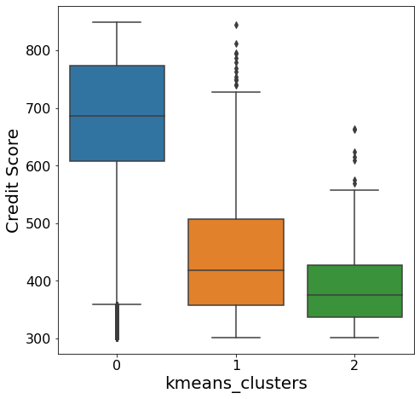
Credit Score
Comparison
Credit Score Clustering
The low-risk group has the highest credit score by far, followed by group 1 and group 2 with the lowest score.
This suggests that credit score is important for determining the group to put the policyholder in.

Slide 6
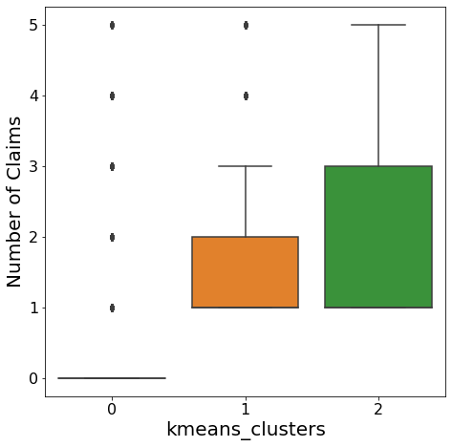
Number of Claims
Comparison
Claim Count Clustering
Obviously, the higher risk groups have more car insurance claims than the low-risk group.

Slide 7
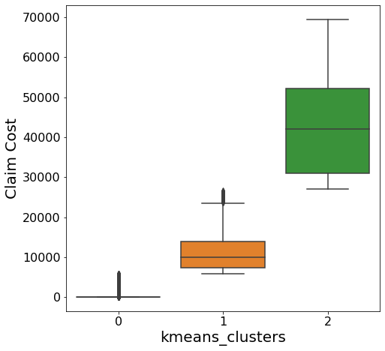
Claim Cost
Comparison
Claim Cost Clustering
The high-risk group has the highest claim cost by far out of any of the groups.

Slide 8
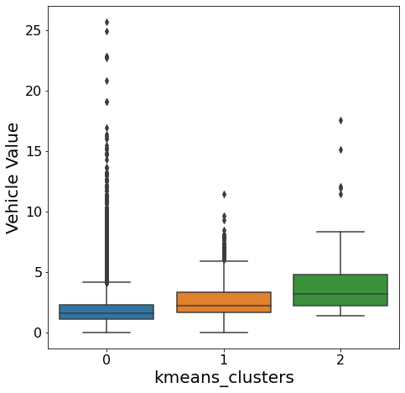
Vehicle Value
Comparison
Vehicle Value Clustering
As you can see, the riskier group has a slightly higher value cars than the moderate risk group and the low-risk group.
This is another important factor.

Slide 9
Groupings
Group 1 – high credit score, cheaper cars, no claims, and low claim cost in the event of a claim
Group 2 – Low-average credit score, slightly more expensive cars, some claims, and moderate claim cost
Group 3- Low credit score, most expensive cars, multiple claims, and high claim cost

Slide 10
Recommendation
My recommendation is that we charge group 1 the lowest premium, group 2 a medium premium, and group 3 a high premium.

Slide 11
Methodology Behind the Recommendation
Data Pre-processing
Data Summary Review
Clustering in Python
Analysis

Slide 12
Pre-Processing the Data
Several rows were dropped before computing.
Date of birth and area were removed because there are already better metrics for those groups (age group and traffic score respectively)
Claim office, policy number, policy effective date, and annual premium were all removed because they are irrelevant to the problem.
Gender and vehicle body type were excluded to reduce runtime of the code.

Slide 13
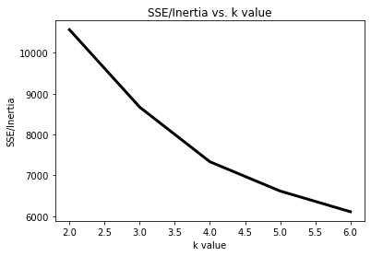
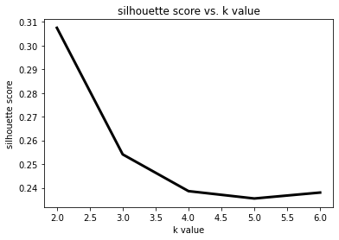
Clustering Methods
K-means: The elbow method and silhouette score suggested 3 clusters
This was good because 3 groups is a much easier implementable policy than 6 or 7 clusters.

Slide 14
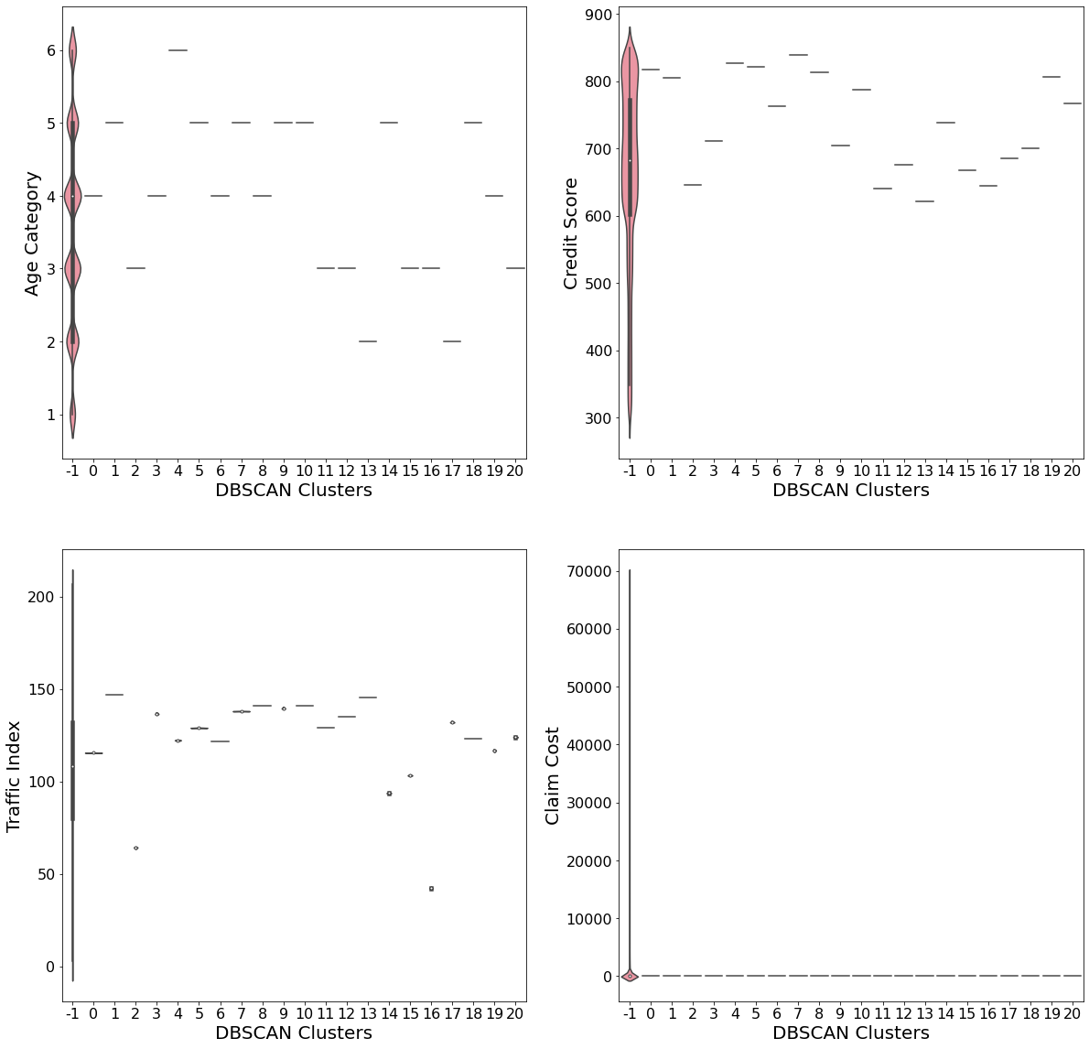
Clustering Methods Continued
DBSCAN
Based on the intuitive clustering found in k-means and high silhouette score for the dbscan, I decided to use eps .51 and min samples of 3
Almost all data fell into one group, making this an ineffective clustering method.

Slide 15
Analysis
Summary
Based on the box plots from the k-clusters data, the most important factors for determining the grouping are. 1. Cost of Claims 2. Number of Claims 3. Vehicle value 4. Credit Score

Slide 16
Questions?
A ben cox presentation: Msc 550

